Slide 1

Crafting ColdFusion
Applications Like An Architect

Slide 2

Who am I
Shirak Avakian
Enterprise Solution Architect
QBI LLC
I code too
shirakavakian@gmail.com
@shirakavakian

Slide 3
Subjects to Cover
Questions to answer
Software architect vs building architect
Software architect vs code

Slide 4
Questions to Answer
Read Initial specification
Visualize
Know your environment
Meet with users ( not managers )
Write down any manual process
Draft your solutions
How do I start a project?
How do I find resources?
How do I collect business
requirements?
How to prepare my demo for
upper management.?
Timeline/budget
Define/Find resources
Craft your first demo

Slide 5
Questions to Answer
How to design my business entities?
Normalize Backend (database) SQL/No SQL
Do not overwhelm your OOP
Generate Table Objects / DAO
Do I need services/API?
Yes if you want to serve somewhere else
Yes if you want to make your application loosely coupled
No for else
Do I need framework?
Yes (period)
No if you want to demo proof of concepts
No if you want to embarrass yourself
How to make my code cleaner?
Follow one coding standers and be consistence
Write comments
Clean up your code

Slide 6

Understanding Software Architect

Slide 7
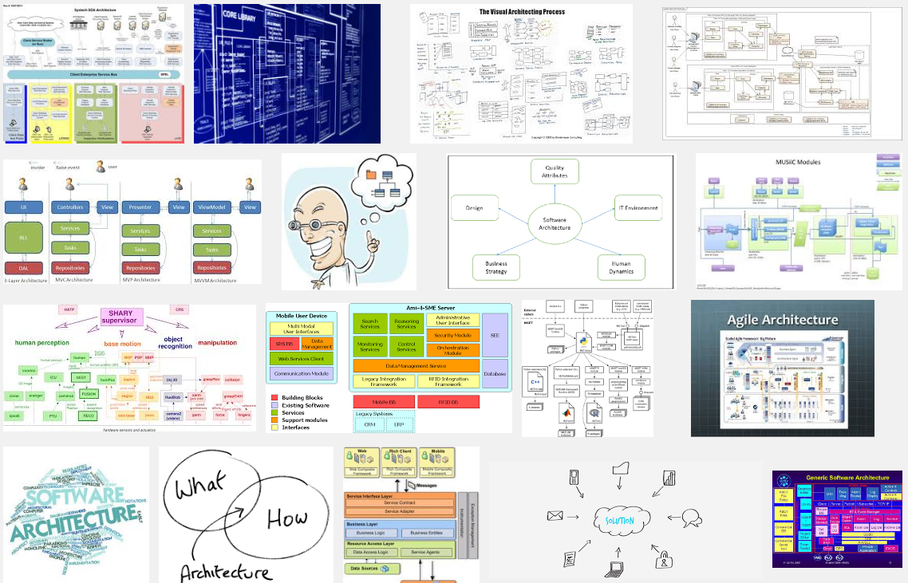
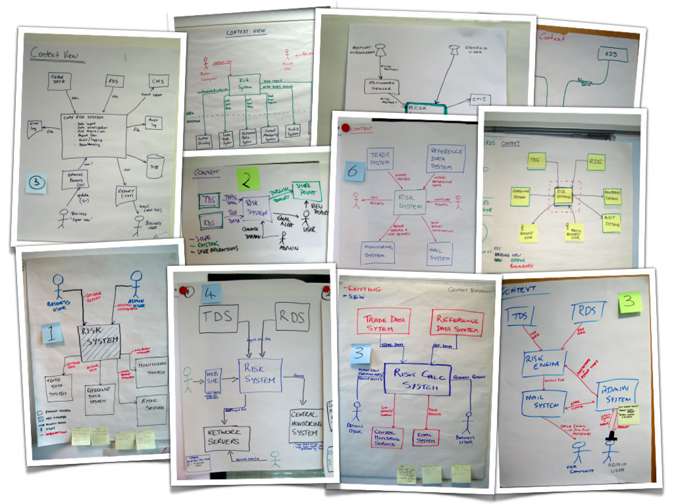
Software Architect

Slide 8
Software Architect
Software architecture refers to the high level structures of a software system, the discipline
of creating such structures, and the documentation of these structures.
Facts
Software architecture is about making fundamental structural choices which are costly to change once implemented.
Software architecture is all about structures not technology
Software architecture must have long term vision
Business requirement is a key factor to start software architect
Communication in software architect play big role on final outcome
Software architect should represent your system without compromises.
Abstraction (reducing the details)

Slide 9
Software Architect vs Building Architect

Slide 10

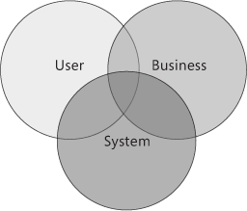
Software Architect vs Building Architect
Building Architecture: Is both the process and the product of planning, designing,
and constructing buildings and other physical structures.
Software Architecture: Is both the process and the product of planning, designing,
and coding softwares and other physical/digital requirements.

Slide 11
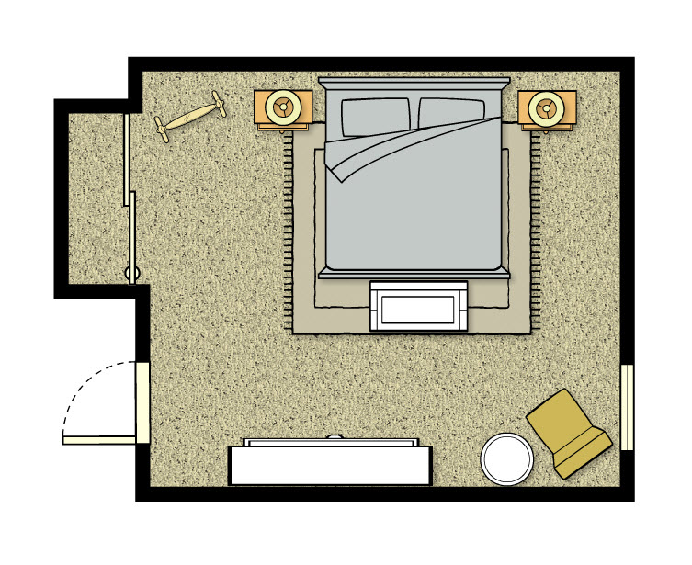
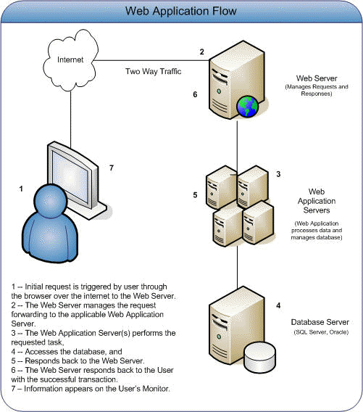
Software Architect vs Building Architect
Building room floor plan
Application servers diagram

Slide 12
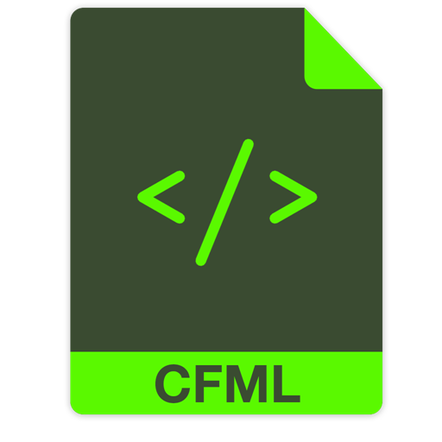
Let us convert the room to ColdFusion code

Slide 13
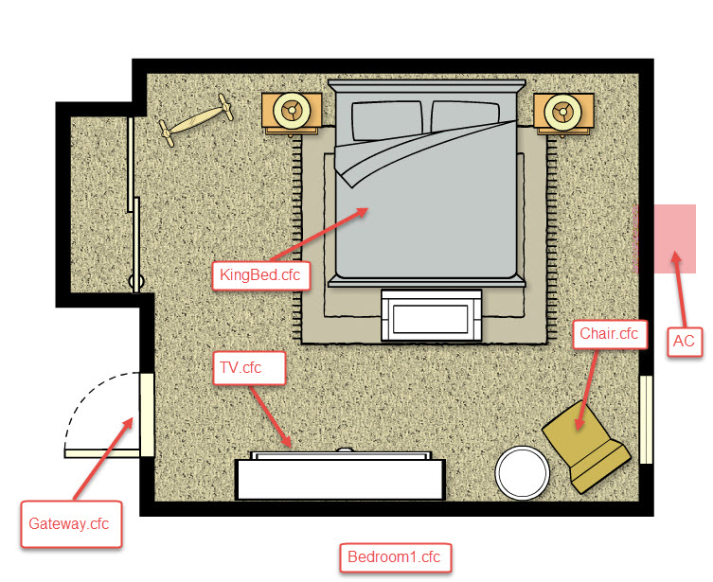
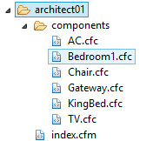
Software Architect vs Building Architect
How do I know which method belong to which component?
Ask the component! If it make sense then it belongs to it
Example: HasChair() method makes total sense when you ask the Bedroom1.cfc
Can you ask Bedroom1 HasCar()? NO
See Architect 01 source code

Slide 14
Software Architect vs Building Architect
Structure
Bedrom1
AC
Furniture
KingBed
Operations
getACType
TV
getChairColor()
Chair
hasChair()
hasTV()
hasBed()
hasFurniture()
Service Factory
Building
Packages
Business functions/objects
Services
See Architect 02 source code

Slide 15
Software Architect vs Code

Slide 16
Software Architect vs Code
Multi layer design
View 1
Service 1
Repository 1
View 2
Service 2
Repository 2

Slide 17
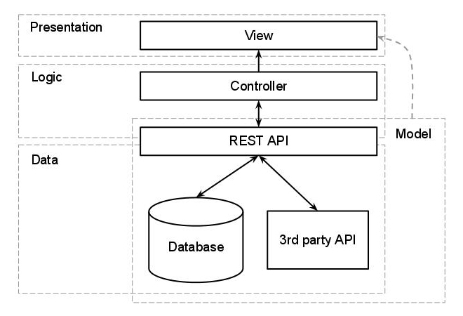
Software Architect vs Code
The MVC

Slide 18
Software Architect vs Code
Repository/Database
OOP (Object Oriented Programing)
SOA (Service Oriented Architect)
UI

Slide 19
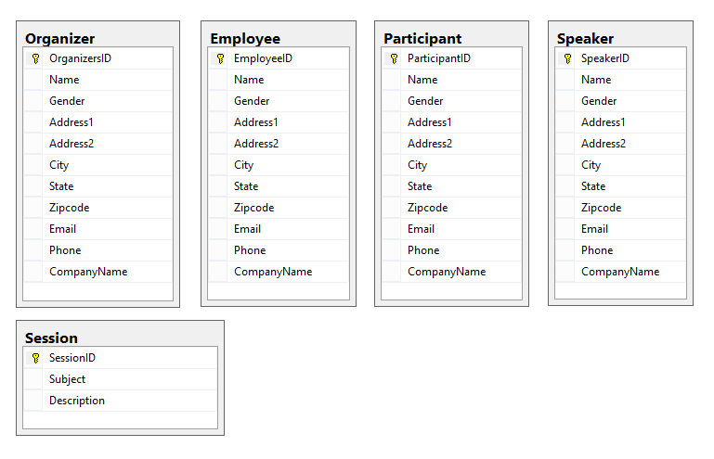
Software Architect vs Code
1- Database/Repository 1 of 2
Database normalization, or simply normalization, is the process of organizing the columns (attributes) and tables (relations) of a relational database to minimize
data redundancy.(Wikipedia)

Slide 20
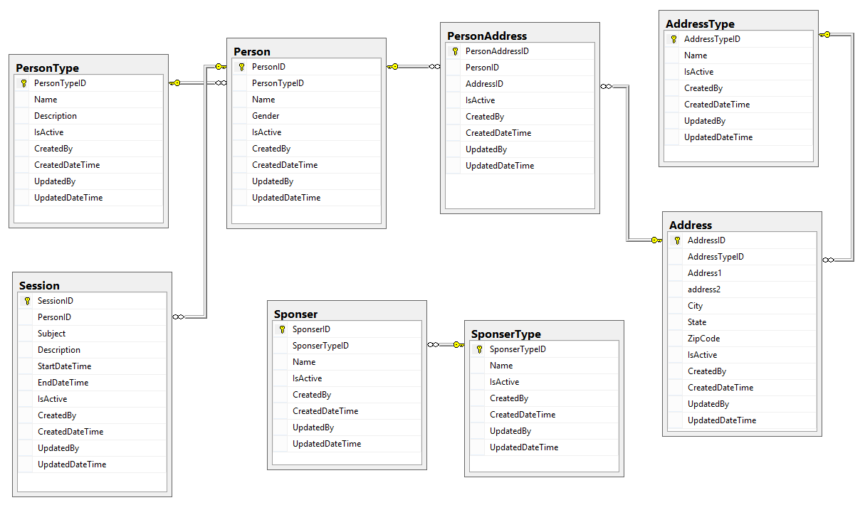
Software Architect vs Code
1- Database/Repository 2 of 2
Database Best Practices
1- Normalize your database
2- Create separate SQL authentication
3- Create schemas
4- Create user defined type
5- Use Store procedures & views
6- Prefix store procedures with usp
7- Don’t use plural form for table name
8- Always create diagrams
9- Use constrains & foreign key’s
10- Use SQL Identity Increment
11- Define your primary keys
12- Always have common fields (columns)

Slide 21
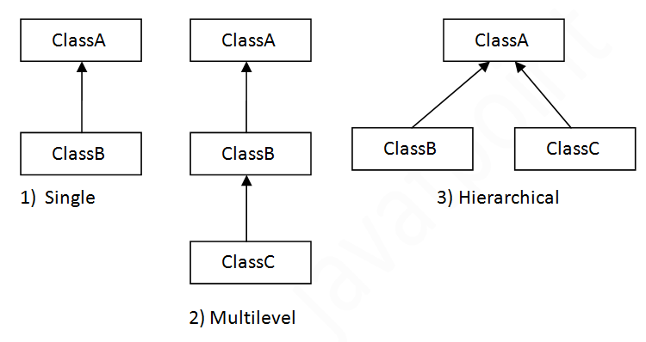
Software Architect vs Code
2- OOP (Object Oriented Programing) 1 of 3
Inheritance is a mechanism in which one object acquires all the properties and behaviors of parent object. The idea behind inheritance is that you can create new classes that are built upon existing classes.
(www.javatpoint.com/inheritance-in-java)

Slide 22
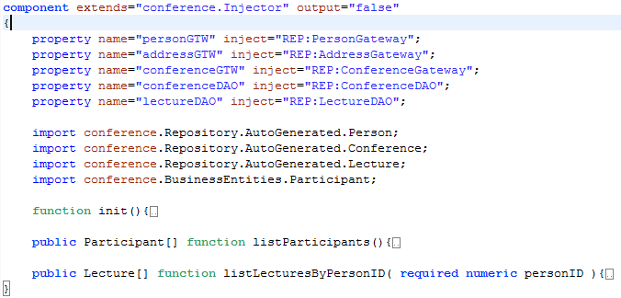
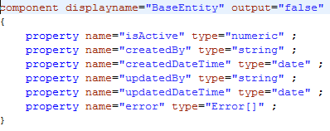
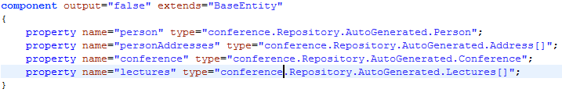
Software Architect vs Code
2- OOP (Object Oriented Programing) 2 of 3
BusinessEntities (objects,valueobjects,beans) is predefined objects represent specific data container for given operation.

Slide 23
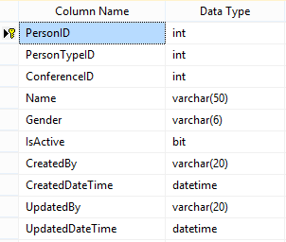
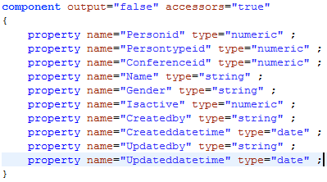
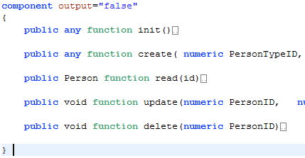
Software Architect vs Code
2- OOP (Object Oriented Programing) 3 of 3
Person Table
Person.cfc (Table Object)
PersonDAO.cfc (Data Access Object)

Slide 24
Software Architect vs Code
2- OOP (Object Oriented Programing) 2 of 4
DAO (Data Access Object) vs DAL (Data Access Layer)
PersonDAL.cfc (Data Access Layer)
PersonDAO.cfc (Data Access Object)
1- No Inheritance
2- Represent single table
3- No Injectors
4- Output array of table object or query
1- Inheritance
2- Represent multiple table
3- Injectors
4- Output array of Business entities or Procedure struct or query

Slide 25
Software Architect vs Code
3- SOA (Service Oriented Architect) 1 of 5
CSOA ( Classic Services Oriented Architect )
SFOA ( Service Factory Oriented Architect )
POA (Package Oriented Architect )
 | Advantages | Disadvantages
1 | Service Reusability | Increased Overhead
2 | Maintainability | Complex Service Management
3 | Reliability | High Investment Cost
4 | Location Independence
5 | Improved Software Quality
6 | Platform Independence
7 | Increased Productivity
A service-oriented architecture (SOA) is an architectural pattern in computer software design in which application components provide services to other components via a communications protocol, typically over a network. The principles of service-orientation are independent of any vendor, product or technology. (https://en.wikipedia.org/wiki/Service-oriented_architecture)

Slide 26
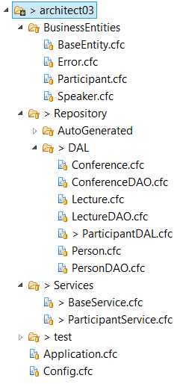
Software Architect vs Code
SOA (Service Oriented Architect) 2 of 5
Classic Service Oriented Architect
UI-Model
ParticipantService
ParticipantService
ParticipantDAL
ParticipantDAL
Database
listParticipant()
listParticipants()
See Architect 03 source code

Slide 27
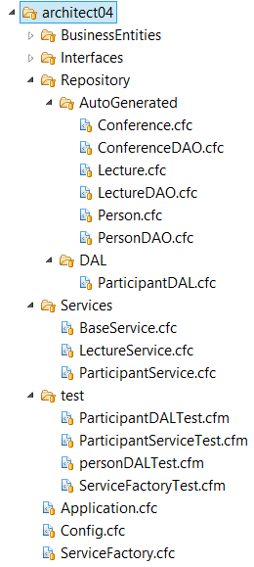
Software Architect vs Code
SOA (Service Oriented Architect) 3 of 5
Service Factory Oriented Architect
UI-Model
Service Factory
LectureService
ParticipantService
Validation
LectureDAL
ParticipantDAL
OtherDAL
See Architect 04 source code

Slide 28
Software Architect vs Code
SOA (Service Oriented Architect) 4 of 5
Package Oriented Architect
Implementations
Contact Gateway
Business Entities
Base Entity
Error
Common Entities
Auth Gateway
Contact Service
Contact DAL
Login Service
Auth DAL
Person DAO
Address DAO
Identity
Role Service
Auth DAL
Login
Role
Translator
Translator
Translator
UI
Container
API
See Architect 05 source code

Slide 29
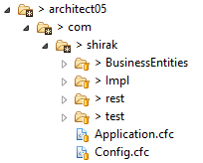
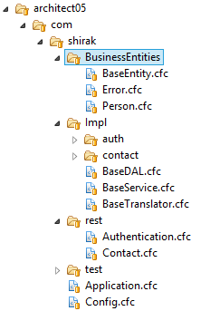
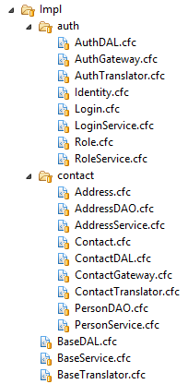
Software Architect vs Code
SOA (Service Oriented Architect) 5 of 5
Package Oriented Architect
UI
Container
API
See Architect 05 source code

Slide 30
UI/UX – User Interface/Experience

Slide 31
Software Architect vs Code
4 – UI/UX User Interface/User Experience 1 of 4
UI
Services
Repository
Things to consider
Complete Isolation
Loosely coupled
Pluggable
Modular
CFML
CFC
SQL
jQuery
AngularJS
3rd Party API
File System
See Architect 05 source code

Slide 32




Software Architect vs Code
4 – UI/UX User Interface/User Experience 2 of 4
an application framework consists of a software framework used by software developers to implement
the standard structure of an application. (Wikipedia)
Why Framework
ColdFusion Frameworks
Keep your team focus on business layer
Everyone in your team will follow same structure
Already tested
Save time and money
Easy to train new hire
Separation of concern
Coldbox
Framework One
CFWheels
Fusebox
See Architect 06 source code
See Architect 05 source code

Slide 33
Software Architect vs Code
4 – UI/UX User Interface/User Experience 3 of 4
Model view controller (MVC) is a very useful and popular design pattern.
Unfortunately it's also one of the hardest to truly understand.
Controller
View
Model
The controller provides model data to the view,
and interprets user actions such as button clicks.
The controller depends on the view and the model.
The model represents the data. The model does NOT depend on the controller or the view.
The view displays the model data, and sends user actions (e.g. button clicks) to the controller.
See UI source code

Slide 34
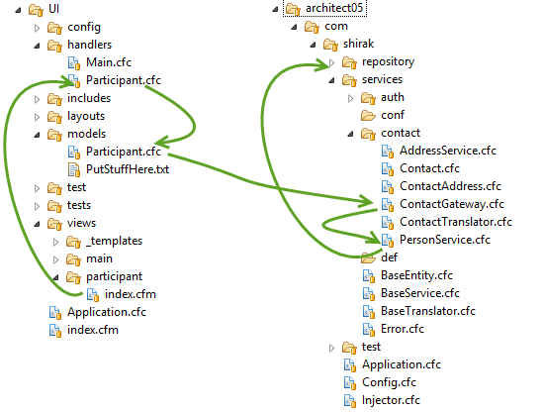

Software Architect vs Code
4 – UI/UX User Interface/User Experience 4 of 4
UI & Service on same server
http://myapp/index.cfm/Participant
URL request to render the view through the handler
Handler request the data from the model
Model create service instance
Model makes a call to the service
Handler gets the data from the model
Handler generates the view model (RC)
Handler render the page (View)
See Architect 05 source code

Slide 35
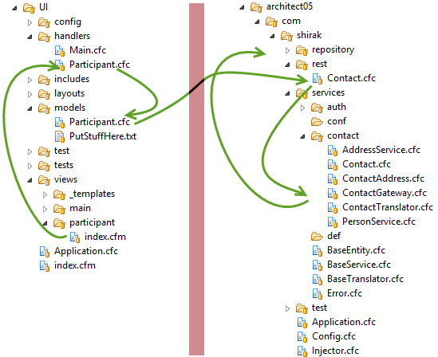

Software Architect vs Code
4 – UI/UX User Interface/User Experience 4 of 4
Different servers
Server 1
Server 2
http://myapp/index.cfm/Participant
URL request to render the view through the handler
Handler request the data from the model
Model create service instance
Model makes a call to the REST service
Handler gets the data from the model
Handler generates the view model (RC)
Handler render the page (View)

Slide 36
Thank You
Questions?
Resources
Don’t leave hold of your common sense. Think about what you’re doing and how the technology can enhance it.
Don’t think about technology first.
(Esther Dyson)
https://acrobat.adobe.com
http://www.scandit.com/
http://developers.itextpdf.com
Source Code
https://github.com/cfclick/CFSummit2016

